Slide 1
Lesson 10 Final Project
Tameka Gillett
Intermediate Statistics

Slide 2

Specifications Needed
Identify the statistic to be run
Test the appropriate assumptions
State the conclusion
There will be exactly one scenario each for the following hypothesis tests:
One-Way ANOVA
One proportion z test
Two proportion z test
Independent Chi-Square

Slide 3
Scenario 1
Fawn is a private investigator. She has taken a job for an insurance company. The insurance company has been paying out large amounts of money for workman’s comp claims, and they believe some of those claims are fraudulent. The insurance company wants Fawn and her associates to run surveillance to determine if the rate of fraud is higher than what the industry normally reports. Specifically, they want to know if the incidence of fraud among claimants is more than 16%.
They provide Fawn with a random sample of 94 claimants who have been diagnosed as unable to perform any physical labor beyond light housekeeping activities. They have asked Fawn to observe the sample, and report back to them how many of the claimants are obviously doing things that are much more strenuous than light housekeeping, such as strenuous yard work, weightlifting at the gym or other strenuous sporting activities, etc.
Fawn and her team spend about 8 weeks completing their observations, and report back to the insurance company that 28 of the 94 claimants are not nearly as “disabled” as their diagnosis suggests. The insurance company wants to test the data.
Complete a report for grading. The only data you need is to know that 28 of the 94 claimants are not nearly as “disabled” as their diagnosis suggests, and the hypothetical level of fraud is 16%.

Slide 4

Scenario 1
Identify the statistic to be run – One Proportion Z-test because we are testing one object against a whole, and we have a percentage.
28 of the 94 claimants are not nearly as “disabled” as their diagnosis suggests, and the hypothetical level of fraud is 16%.

Slide 5
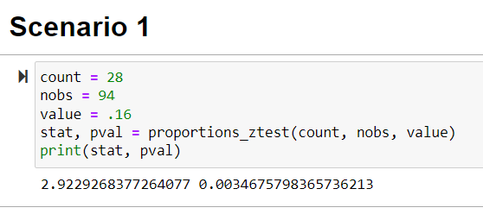
Scenario 1
Test the appropriate assumptions

Slide 6
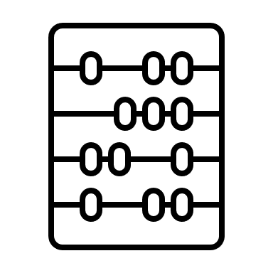
Scenario 1
State the conclusion
The p-value is 0.0035 which is smaller than 0.05 which means that it is different from 16%
Therefore, 16% of hypothetical level fraud is not accurate.
I will suggest to reject this hypothesis and gather more data to analyze.

Slide 7
Scenario 2
Medical researchers are trying to understand if four topical antiseptics are being used in the same ratio at three different clinics in town. They have access to medical records over the past 3 years and have recorded each treatment where a topical antiseptic was used.
Using a tally sheet, they have determined how many times each antiseptic was used in each of the three clinics, and they want to compare the antiseptic usage across the three clinics.
Complete a report for grading. The data can be found in the following file: Antiseptic Data.

Slide 8
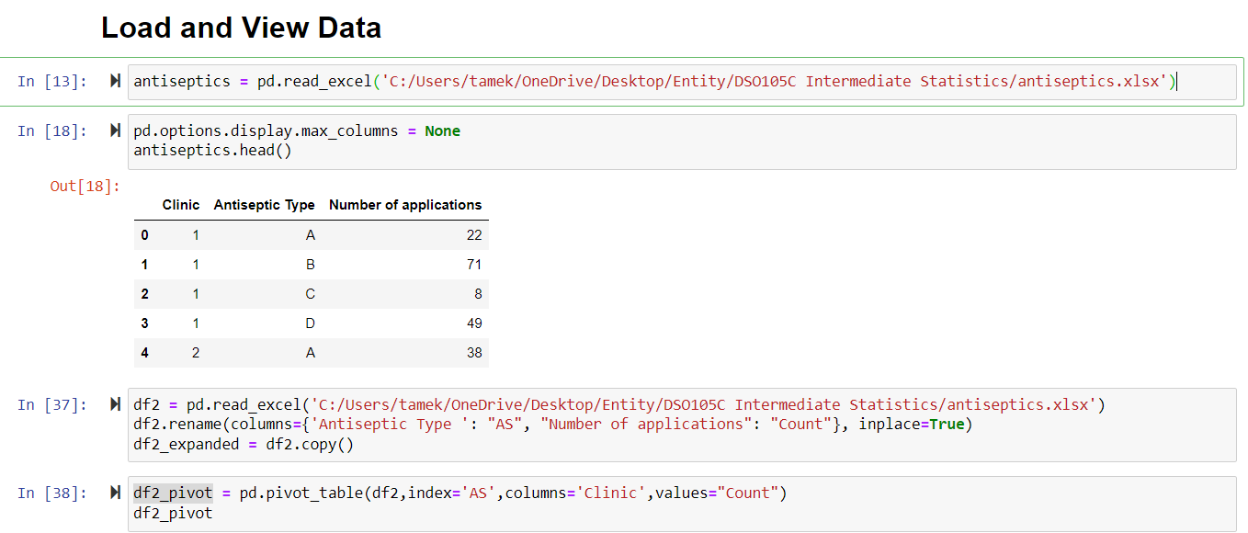
Scenario 2

Slide 9
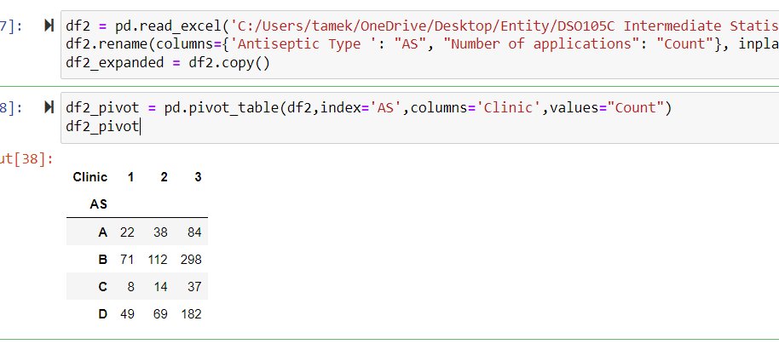
Scenario 2

Slide 10
Scenario 2
Identify the statistic to be run –
Independent Chi-Square
Result: I am running this to see the association between the categorical variables antiseptics to clinics

Slide 11
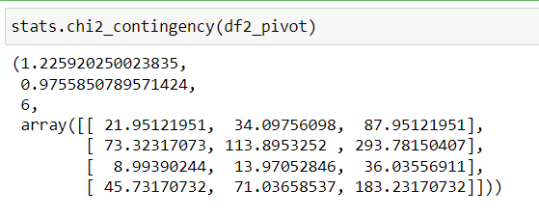
Scenario 2
Test the appropriate assumptions
State the conclusion
This shows that the p-value is greater than 0.05.
I will accept the null hypothesis because there is no difference from antiseptics to clinics
All of the assumptions are greater than 5, so we meet the assumptions as well

Slide 12

Scenario 3
A financial institution is interested in the savings practices of different demographic groups. They have demographic data for all of their account holders, and have used those criteria to split their customers up into 4 groups.
They are going to use the results to do some targeted marketing. In order to determine savings practices, they are going to use the average savings account balance over the past 3 months for their account holders. In other words, they will have one number (average account balance) for each account.
Each demographic group has between 40 and 60 accounts they will look at.
Complete a report for grading.

Slide 13
Scenario 3
Identify the statistic to be run –
One proportion z test
Test the appropriate assumptions
State the conclusion

Slide 14
Scenario 4
The local school board conducted a poll to gauge public sentiment about a school bond. They asked respondents if they favored or opposed a bond in the upcoming election. The respondents were asked some demographic questions, too.
Complete a report for grading. The counts for the different groups are as follows:
With school age children and favorable - 374
With school age children and unfavorable - 129
Without school age children and favorable - 171
Without school age children and unfavorable - 74
Use these data to complete your analysis and use alpha = 0.05.

Slide 15
Scenario 4
Identify the statistic to be run –
Two Proportion Z-test
Test the appropriate assumptions
I’m comparing With and Without school age children AND Favorable and Unfavorable

